Slide 1
The F distribution
Comparing Population Variances

Slide 2
Comparing Population Variances
We have dealt with ways to compare both means and proportions from two populations.
Now, what if we wanted to compare two population variances. For example, which of two machines has the least amount of variability? Or which test has the least variability in scores?

Slide 3
Comparing Inferences
To test a hypothesis of equal variances (or spread or variability)
Ho: s₁ ²=s₂ ² is tested against Ha: s₁ ² ≠ s₂ ²
by a simple statistic, the ratio of sample variances.
Our test statistic, F=
Assumptions: We have independent SRSs from two Normal populations

Slide 4
The F-distribution
When these assumptions are satisfied and the null hypothesis is true (that is s₁ ²=s₂ ² ), then the sampling distribution of F= is the F-distribution with (n₁-1) degrees of freedom in the numerator and (n₂-1) degrees of freedom in the denominator.
The shape of the F distribution depends on the degrees of freedom

Slide 5
Using the Table
Assume that we have two samples with:
n₁ = 7 and n₂ =10
df = 7-1= 6 and df = 10-1= 9
Let v = F(6,9)
where 6 is the df from the numerator and 9 is the df of the denominator.
Using the 0.05 table with the appropriate df, we find P(v > 3.37) = 0.05. OR the critical value for our test is 3.37

Slide 6
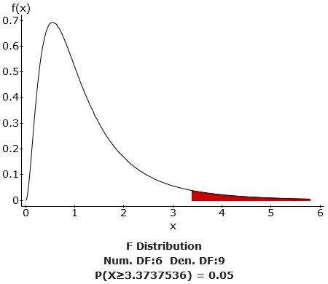

Slide 7
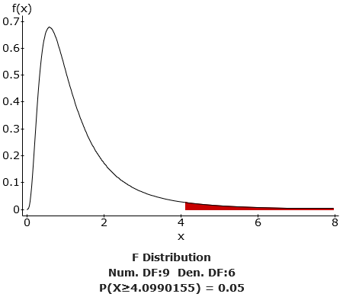
DANGER! Look what happens if you reverse the df values

Slide 8
Example: Reading test scores for slow learners using two methods
Determine if these two methods have the same population variance at the α=0.10 level of significance
Old Method
New Method
80 80 66 85
76 79 71 81
70 76
79 62 70 68
73 76 86 73
72 68 75 66

Slide 9
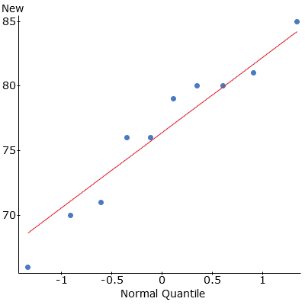
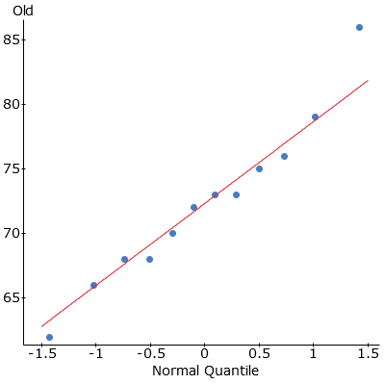
We want to test Ho: s₁ ²=s₂ ² against Ha: s₁ ² ≠ s₂ ²
Check assumptions: two SRSs from two normal populations

Slide 10
Hypothesis Test to Compare Two Variances
1. Formulate the null and alternate hypotheses.
H₀: σ₁²= σ₂²
H_{a}: σ₁²> σ₂²
[Note that we might also use σ₁² < σ₂² or σ₁² =/ σ₂²]
2. Calculate the F ratio.
F = s₁²/s₂² [where s₁ is the largest or the two variances]
Reject the null hypothesis of equal population variances if
F(v₁-1, v₂-1) > Fα [or F_{α/2} in the case of a two tailed test]

Slide 11
Calculate the test statistic
Column n Variance
New 10 34.04
Old 12 40.24
F = 40.24/34.04 = 1.1821 TEST STATISTIC

Slide 12
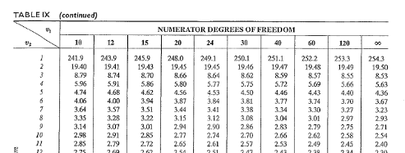
Critical Value is between 3.07 and 3.14 using Table

Slide 13
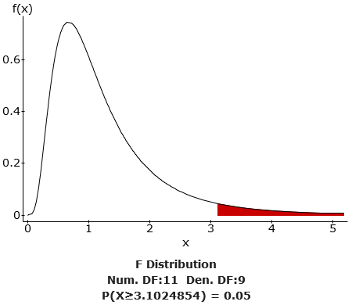
Or Critical Value = 3.10 using Statcrunch

Slide 14
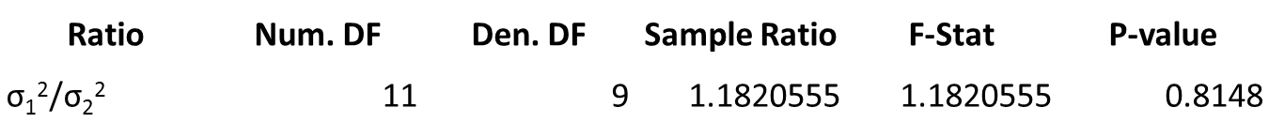
Decision?
As our test statistic of 1.18 does not exceed the critical value of 3.10, we fail to reject the null hypothesis.
OR
Fail to reject as p-value of 0.8148 is greater than the α =0.10.

Slide 15
Conclusion in Context
There is not sufficient evidence to state that the variances for the two methods of teaching are not the same at the 0.10 level of significance.

Slide 16
Example #2 Variability of Test Scores between Males and Females
Researchers believe that the test scores of males are more variable than the test scores of females on a standardized math test. Results of on a standardized test are shown below.
 | Sample Size | Mean | Standard Deviation
Males | 1,764 | 48.9 | 12.96
Females | 1,739 | 48.4 | 11.85

Slide 17
H₀: σ_{m}²= σ_{f}² H_{a}: σ_{m}²> σ_{f}²
Assume all assumptions for inference have met satisfied
^{Test} Statistic = 12.96²/11.85² = 1.19611
Df numerator = 1763
Df denominator= 1738

Slide 18
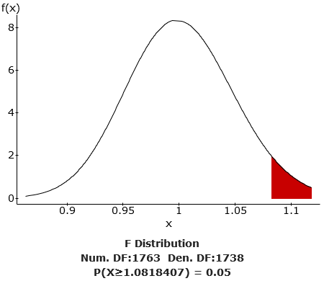

Slide 19
Hypothesis test results: σ₁² : Variance of population 1 σ₂² : Variance of population 2 σ₁²/σ₂² : Ratio of two variances H₀ : σ₁²/σ₂² = 1 H_{A} : σ₁²/σ₂² > 1
Ratio | Num. DF | Den. DF | Sample Ratio | F-Stat | P-value
σ₁²/σ₂² | 1763 | 1738 | 1.0936709 | 1.0936709 | 0.0306

Slide 20
Decision??
Using Critical Value
Using p-value
Reject Ho
Test Statistic of 1.19 exceeds critical value of 1.08
Reject Ho
P-value of 0.03< α=0.05

